Slide 1
Entity Framework Core
EF Core Code First

Slide 2
Lesson Objectives
Data Annotations Attributes
Entity Mappings
Property Mappings

Slide 3
Data Annotations Attributes
Section 1

Slide 4
Data Annotations
Code-First Conventions is default, simple, powerful but not cover advanced cases
More specific data type and constrains
Name of user is not exceed 100 characters, I don’t want to create nvarchar(Max)
Age of user is in range 0 – 150, let’s set the constrains to check this
Column name, table name in SQL have space
Many-to-Many relationships

Slide 5
Data Annotations
Data annotation attributes are the same in EF 6 and EF Core
A simple attribute based configuration
Can apply to domain classes and its properties
Included in a separate namespace
System.ComponentModel.DataAnnotations
System.ComponentModel.DataAnnotations.Schema

Slide 6
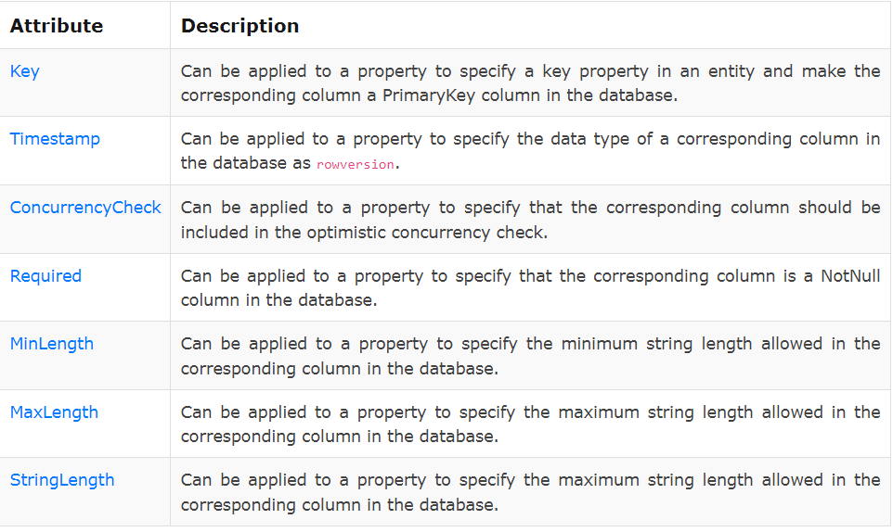
System.ComponentModel.DataAnnotations
System.ComponentModel.DataAnnotations Attributes

Slide 7
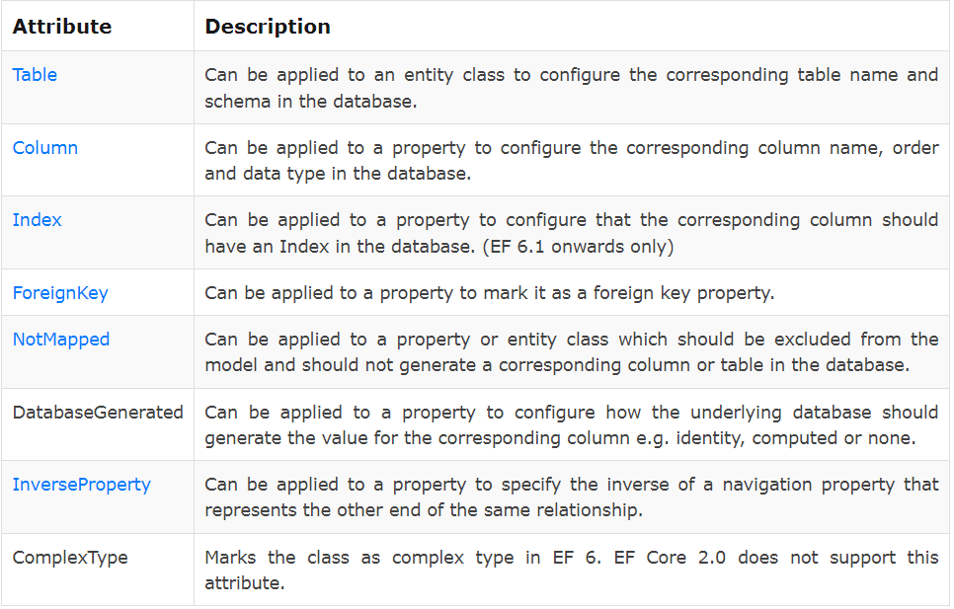
System.ComponentModel.DataAnnotations.Schema
System.ComponentModel.DataAnnotations.Schema Attributes

Slide 8
Data Annotations - Table Attribute
The Table attribute can be applied to a class to configure the corresponding table name in the database.
It overrides the default convention.
What is default schema?
What is convention for table name?
Format: [Table(string name, Properties:[Schema = string])
name: Name of the Db table.
Schema: Name of the Db Schema in which a specified table should be created. (Optional)

Slide 9
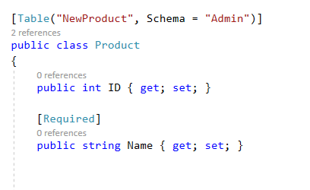
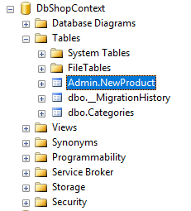
Data Annotations - Table Attribute
[Table("NewProduct", Schema = "Admin")]

Slide 10
Data Annotations - Column Attribute
Which are default conventions for column?
Column name
Data type
Order

Slide 11
Data Annotations - Column Attribute
The Column attribute can be applied to one or more properties in an entity class
Format: [Column (string name, Properties:[Order = int],[TypeName = string])
name: Name of a column in a SQL table.
Order: Order of a column, starting with zero index. (Optional)
TypeName: Data type of a column. (Optional)

Slide 12
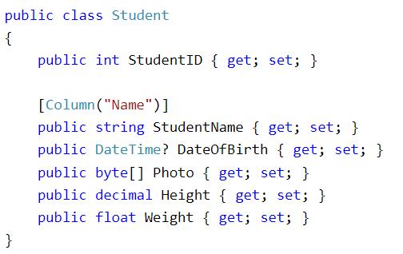
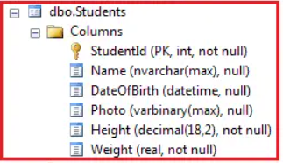
Data Annotations - Column Attribute
Name:
Can put space in SQL column name
Try to keep naming conventions
Similar to entity field to easy finding/understanding
Keep it simple, meaning full

Slide 13
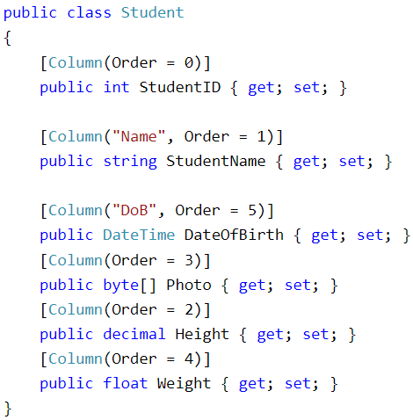
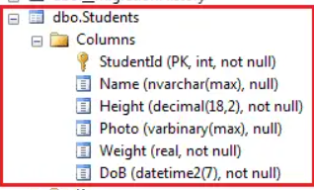
Data Annotations - Column Attribute
Order:
Use the zero-based
Difference values
Do not need to continuity
All ordered columns should come first (in order, of course)
All non-ordered columns should come along, in default order as conventions

Slide 14
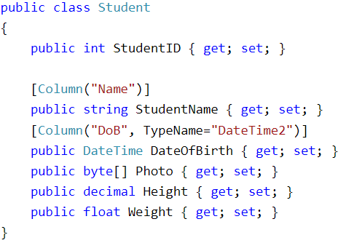
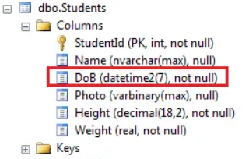
Data Annotations - Column Attribute
TypeName:
To change SQL data type for the column
Accept name of data type in SQL as a string

Slide 15
Data Annotations – Index Attribute
Is used to create an index on a particular column in the database
Format: [Index(string name, Properties:[IsClustered = bool],[IsUnique = bool] ,[Order = int])]
name: name of Index. Default value is: IX_{property name}
IsClustered: to set index is clustered or non-clustered.
IsUnique: to set constrain data is unique or not
Order: to set order of index

Slide 16
Data Annotations - ForeignKey Attribute
Is used to configure a foreign key in the relationship between two entities.
Format: [ForeignKey(name string)]
name: Name of the associated navigation property or the name of the associated foreign key(s).

Slide 17
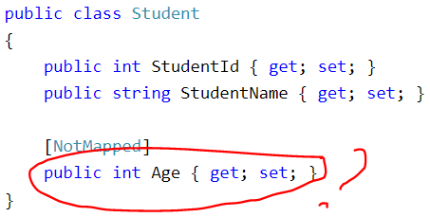

Data Annotations - NotMapped Attribute
Used when we do not want to create corresponding columns in the database.
Format: [NotMapped()]
Discussion: Give an example to use this attribute?
Notes:
For tempraty field

Slide 18
Data Annotations - InverseProperty Attribute
Is used when two entities have more than one relationship.
Format: [InverseProperty(string property)]
property: The navigation property representing the other end of the same relationship.
The attribute always set on the left-hand (set to property of the parent entity)

Slide 19
Data Annotations - Key Attribute
What is default convention for PrimaryKey?
How to set PrimaryKey for non-formatted field?
How to set PrimaryKey for multiple columns?
How to use Find method for PrimaryKey with multiple columns?

Slide 20
Data Annotations - Key Attribute
Applied to a property in an entity class to make it a key property.
Corresponding column to a PrimaryKey column in the database
Format: [Key]

Slide 21
Data Annotations - Key Attribute
EF Core does not support creating a composite key using the Key attribute. You have to use the Fluent API HasKey() function in EF Core.

Slide 22
Data Annotations - Required Attribute
EF Core will create a NOT NULL column in a database table.
Can be applied to one or more properties in an entity class.
Format: [Required]
AllowEmptyStrings: to accept empty string or not
Required attribute inherit from Validation attribute. Therefor:
ErrorMessage: The error message is thrown when the property associated with the validation control is invalid.

Slide 23
Data Annotations - MaxLength Attribute
Specifies the maximum length of data value allowed for a property which in turn sets the size of a corresponding column in the database.
It can be applied to the string or byte[] properties of an entity.
Format: [MaxLength(int)]
MaxLength attribute inherit from Validation attribute

Slide 24
Data Annotations - MaxLength Attribute
Example 1:
[MaxLength(50)]
public string ProductName { get; set; }
Should create a field ProductName in SQL with data type is: nvarchar(50)
Example 2:
[MaxLength(1024)]
public byte[] FileContent { get; set; }
Should create a field FileContent in SQL with data type is: varbinary(1024)

Slide 25
Data Annotations - MinLength Attribute
Same context as MaxLength
Specifies the minimum length of data value allowed
Question: How to specify fixed length of the data?
For example: ProductCode is always has 10 characters

Slide 26
Data Annotations - StringLength Attribute
Can be applied to the string properties of an entity class.
Specifies the minimum and maximum length of characters that are allowed in a data field.
User often uses maximum length first, then minimum.
Format: [StringLength(int, MinimumLength = int)]

Slide 27
Data Annotations - Range Attribute
Specifies the numeric range constraints for the value of a data field.
Apply the attribute to a data field of type integer.
[Range(int minimum, int maximum)]
Apply the attribute to a data field of type double.
[Range(double minimum, double maximum)]

Slide 28
Data Annotations - Range Attribute
Apply the attribute to a DateTime data field
Range(Type, String, String)
[Range(typeof(DateTime), string minximum, string maximum]
Apply the attribute to a custom data field
The object to validate must implement the IComparable interface.
Range(Type, String, String)

Slide 29
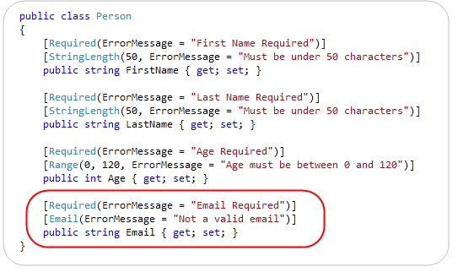
Example: Required, Range, StringLength

Slide 30

Data Annotations - RegularExpression
Enables to validate whether the value of a property matches a specified regular expression pattern.
Format: [RegularExpression(@"regex pattern")]
Notes:
[RegularExpression("regex pattern")]

Slide 31
Data Annotations - Timestamp Attribute
It can only be applied once in an entity class to a byte array type property.
It creates a column with timestamp data type in the SQL Server database.
Entity Framework API automatically uses this Timestamp column in concurrency check on the UPDATE statement in the database
Format: [Timestamp]

Slide 32

ConcurrencyCheck Attribute
The ConcurrencyCheck attribute can be applied to one or more properties in an entity class.
When applied to a property, the corresponding column in the database table will be used in the optimistic concurrency check using the where clause.
The ConcurrencyCheck attribute can be applied to any number of properties with any data type.
The Version property is used to track the version of the entity, and if the version has changed since the entity was retrieved, a DbUpdateConcurrencyException will be thrown

Slide 33
Data Annotations - All Attributes
https://docs.microsoft.com/en-us/dotnet/api/system.componentmodel.dataannotations?view=net-6.0

Slide 34
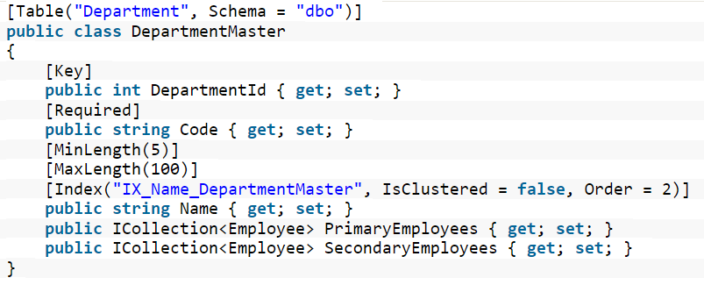
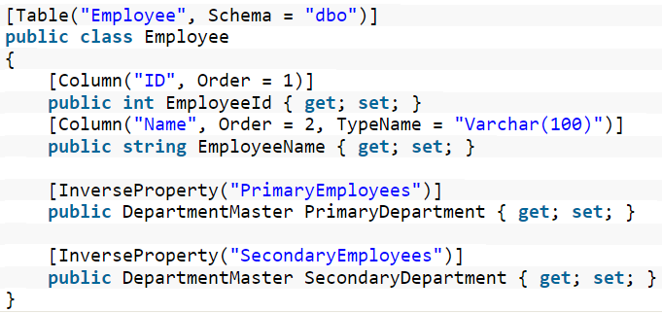
Example

Slide 35

Thank you

